Slide 1
R’s Caret Package
Nora Zakrzewski & Teagan Clark
DSS 445 Midterm Presentation

Slide 2
What is caret?
Created by Max Kuhn in 2007
Essentially the predecessor of the tinymodels package (2019).
Short for “Classification and Regression Training”, it is a comprehensive package for machine learning, offering tools for model training, hyperparameter tuning, and model evaluation across various algorithms.
In simpler terms, caret:
  Trains models (teaches the computer how to make predictions from data)
  Tunes settings (helps you find the best setup for your model)
  Tests accuracy (checks how well your model is doing)
There are over 230 models included in the package including various tree-based models, neural nets, deep learning and much more.

Slide 3
Context
When someone has data and wants to predict something, they usually need to:
  Prepare the data (clean it, scale it, or encode categories)
  Choose a model (like decision trees, logistic regression, or random forest)
  Train the model (so it learns patterns from the data)
  Test how well it works
  Adjust settings to make it more accurate
The Caret package brings all of these steps together in one consistent framework.
It’s used mostly by data scientists and statisticians who work in R

Slide 4
Caret Demo

Slide 5
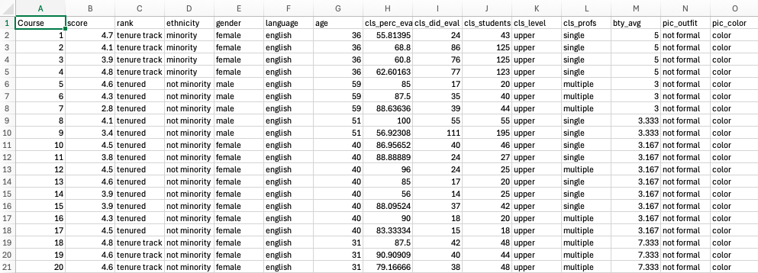
The Data
We will use the Professor Evaluation data (evals.csv) to demonstrate how caret works.
  This dataset explores how different factors might be related to a professor’s teaching evaluation score.
We will use caret to predict scores using all other variables & see which variables are best predictors

Slide 6
Prep
caret loads packages as needed and assumes that they are installed.
Install caret using:
  > install.packages("caret", dependencies = TRUE)
  Dependencies ensure all needed packages are installed
Load in data:
  > evals <- read.csv( "/Users/nora/Desktop/DSS R Programming/Datasets/evals.csv",
  > header = TRUE)
Converting categorical variables to numerical:
  > evals$rank <- as.factor(evals$rank)
  > evals$ethnicity <- as.factor(evals$ethnicity)
  > evals$gender <- as.factor(evals$gender)
  > evals$language <- as.factor(evals$language)
  > evals$cls_level <- as.factor(evals$cls_level)
  > evals$cls_profs <- as.factor(evals$cls_profs)
  > evals$pic_outfit <- as.factor(evals$pic_outfit)
  > evals$pic_color <- as.factor(evals$pic_color)

Slide 7
Building Model
Split data into training (80%) and test (20%) sets
  > set.seed(123)
  > train_index <- createDataPartition(evals$score, p = 0.8, list = FALSE)
  > train <- evals[train_index, ]
  > test <- evals[-train_index, ]
Training a random forest model
  > model <- train(
  > score ~ ., # predict score using all other variables
  > data = train,
  > method = "rf", # random forest
  > preProcess = c("center", "scale"), # standardize numeric variables
  > trControl = trainControl(method = "cv", number = 5) # 5-fold cross-validation
  > )
  > print(model)
We are using Random Forest because it is accurate, less restrictive than a linear model, & offers insight into which input variables are the strongest predictors

Slide 8
Output
Random Forest
372 samples
14 predictor
Pre-processing: centered (15), scaled (15)
Resampling: Cross-Validated (5 fold)
Summary of sample sizes: 298, 297, 298, 298, 297
Resampling results across tuning parameters:
mtry RMSE Rsquared MAE
2 0.4387868 0.3587901 0.3465187
8 0.4334295 0.3592331 0.3401551
15 0.4329532 0.3592219 0.3381422
RMSE was used to select the optimal model using the smallest value.
The final value used for the model was mtry = 15.
RMSE (root mean squared error) ≈ 0.43
  On average, the model’s predictions are off by about 0.43 points on the evaluation scale (1–5).
R² (Coefficient of Determination) ≈ 0.36
  The model explains ≈ 36% of the variation in evaluation scores.
MAE (Mean Absolute Error) ≈ 0.34
  Model predictions are usually within about 0.34 of a point of the true value.

Slide 9
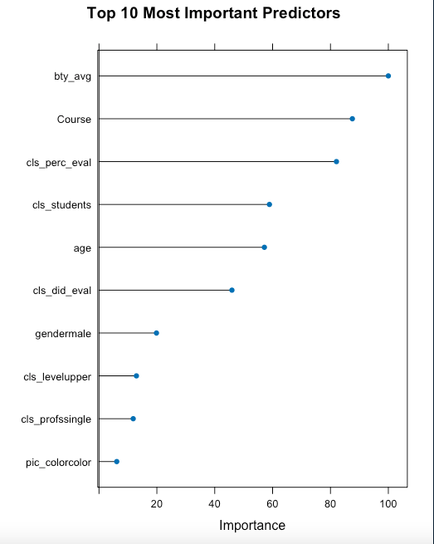
Strongest Predictive Variables
Checking variable importance
  > importance <- varImp(model)
  > print(importance)
Output:
rf variable importance
Overall
bty_avg 100.000
Course 87.566
cls_perc_eval 82.066
cls_students 58.907
age 57.163
cls_did_eval 45.945
gendermale 19.858
cls_levelupper 12.929
cls_profssingle 11.823
pic_colorcolor 6.134
ranktenure track 5.696
ranktenured 3.326
languagenon-english 2.984
ethnicitynot minority 1.057
pic_outfitnot formal 0.000
Plot:
  plot(importance, top = 10, main = "Top 10 Most Important Predictors")
*This shows us that beauty average, course, and % of students who filled out the evaluation in the class are the three strongest predictors of evaluation score.

Slide 10
Questions?

